Slide 1
Software Security
CSC 481/681/781
Principles of Computer Security
Ref: Textbook, Section 3.4

Slide 2
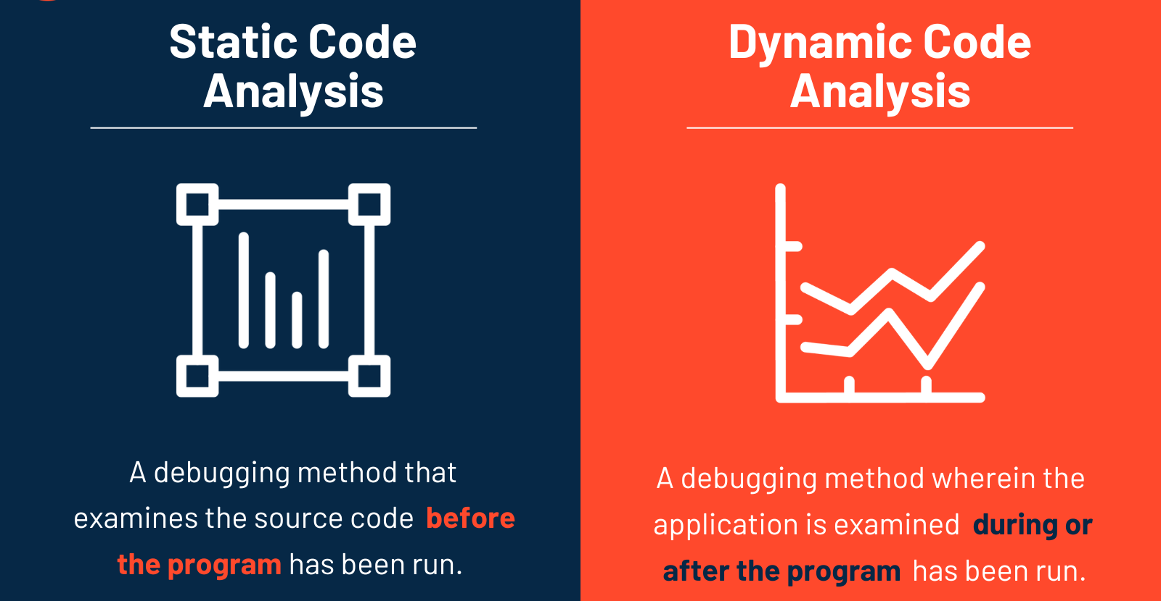
Dynamic Analysis
General Concepts

Slide 3
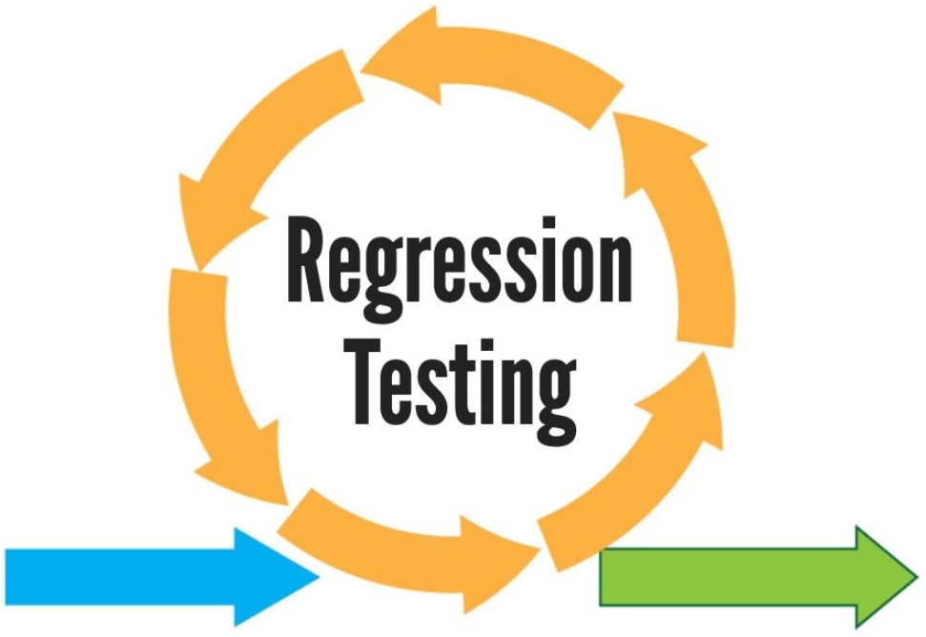
Dynamic Analysis
General Concepts
Idea: Find issues by running the program
Standard testing:
Make test cases - remember error cases!
Regression testing - make sure errors aren’t reintroduced later
Type | When to Use | Key Idea
Corrective | No code changes | Re-run existing tests
Progressive | New features/changes | Add new tests + check old ones
Selective | Small/local changes | Test only affected parts
Partial | New + related old components | Test interactions
Complete | Before release | Test entire system
Retest-All | Major changes | Run all tests (most thorough)

Slide 4
Dynamic Analysis
General Concepts
Instrumenting programs - code modified to help test
Binary instrumentation: no source code needed
strace (system call tracing)
DTrace (library call monitoring)
Valgrind: intercepts and monitors memory operations
Downside: Can seriously slow down execution (Valgrind ≈ 20x)

Slide 5
Dynamic Analysis
General Concepts
Instrumenting programs - code modified to help test
Compiler-inserted instrumentation
Address Sanitizer (ASAN) - can monitor every memory access
Compiler assists for creating test cases
Immediately report errors like buffer overflows

Slide 6
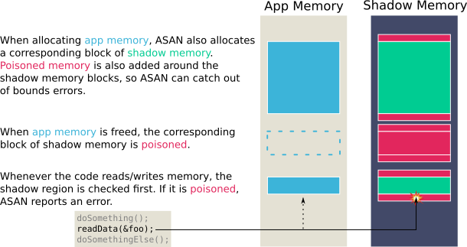
Dynamic Analysis
Address Sanitizer (ASAN)
gcc -fsanitize=address –g –o example

Slide 7
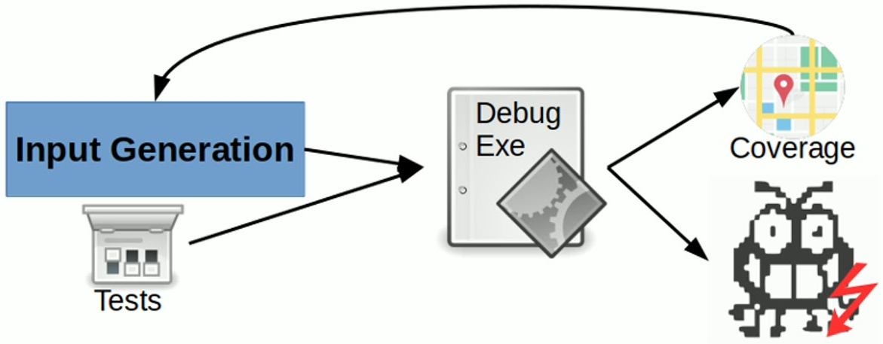
Dynamic Analysis
Fuzz Testing
Types of testing:
White box / Clear box: Use the code!
Black box: Run the code and see what it does
Does it meet functional requirements?
Does it handle unexpected inputs gracefully and securely?
Security vulnerabilities generally come from the unexpected.
Execution paths that aren’t tested because aren’t “normal”
Dismissed in functional testing because “no one would ever do that…”
Fuzz testing idea: fuzzing is an automated software testing method that injects invalid, malformed, or unexpected inputs into a system to reveal software defects and vulnerabilities.

Slide 8
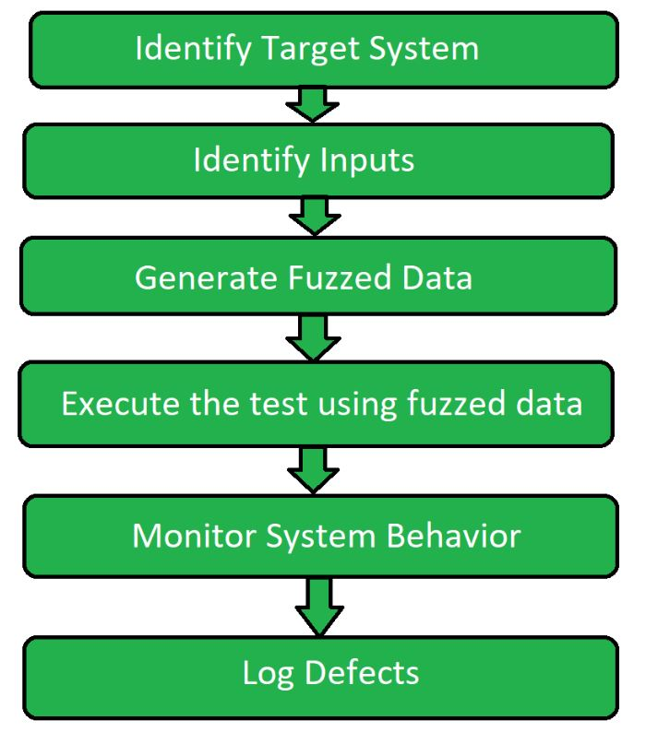
Dynamic Analysis
Fuzz Testing
file-parsing function: File fuzzing
network protocol: Network fuzzing
application programming interface (API): API fuzzing
Classification by Target Scope

Slide 9
Dynamic Analysis
Fuzz Testing
Mutation-Based Fuzzing: Takes valid seed inputs and applies mutations (e.g., bit-flipping, byte modification) to create new, malicious test cases.
Generation-Based Fuzzing: Generates test cases from scratch, adhering to a specific model, grammar, or format of the input.
Evolutionary Fuzzing: Start with existing inputs and uses genetic algorithms to "evolve" inputs over time, keeping those that trigger new code paths and mutating them further.
Classification by Input Generation Method

Slide 10
Dynamic Analysis
Fuzz Testing Examples
A sampling of available tools:
Sharefuzz (old but historically interesting)
“Sharefuzz analyzes suid programs for common buffer overflows and security problems automagically, through the power of LD_PRELOAD.”
Sulley
“A pure-python fully automated and unattended fuzzing framework.”
zzuf
Randomly tweaks inputs from user-provided corpus
Included in common Linux distros (e.g., in Ubuntu: “sudo apt install zzuf”)
American Fuzzy Lop (AFL)
State-of-the-art mainstream fuzz tester
Includes compiler instrumentation for path coverage (more later)
Fuzzing info from OWASP: https://owasp.org/www-community/Fuzzing
Big list from BlackArch Linux disto: https://blackarch.org/fuzzer.html

Slide 11
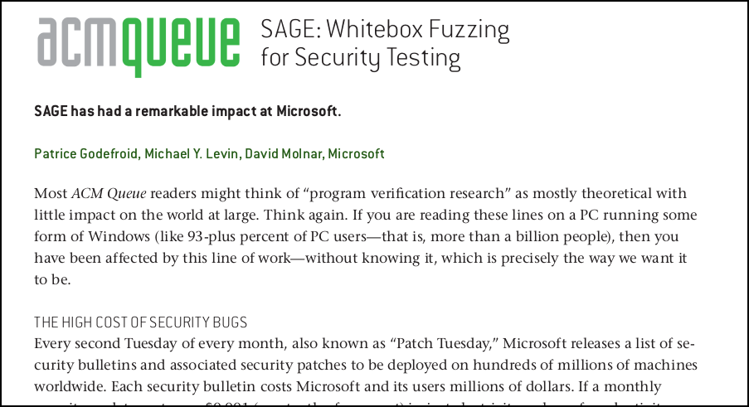
Dynamic Analysis
Fuzz Testing - Compiler assists for code coverage
Whitebox fuzzing combines code analysis, symbolic execution, and fuzz testing.
Fantastic article on practical impact/use at Microsoft:
https://queue.acm.org/detail.cfm?id=2094081

Slide 12
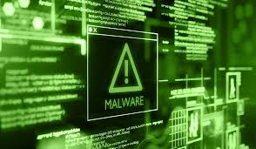
Malware
Definition
Malware is malicious software - acts against owner or user
In Spanish, ‘MAL’ is a prefix that means, ‘BAD’ , making the term ‘bad ware’.
This is software that is specifically designed to gain access or damage a computer without the knowledge of the owner.

Slide 13


Malware
Purpose
To hurt others and make money, usually by affecting important information adversely.
Stealing, encrypting or deleting sensitive data.
Altering or hijacking core computing functions.
Monitoring users’ computer activity without their permission.
To steal personal, financial, or business information from individuals & governments.

Slide 14
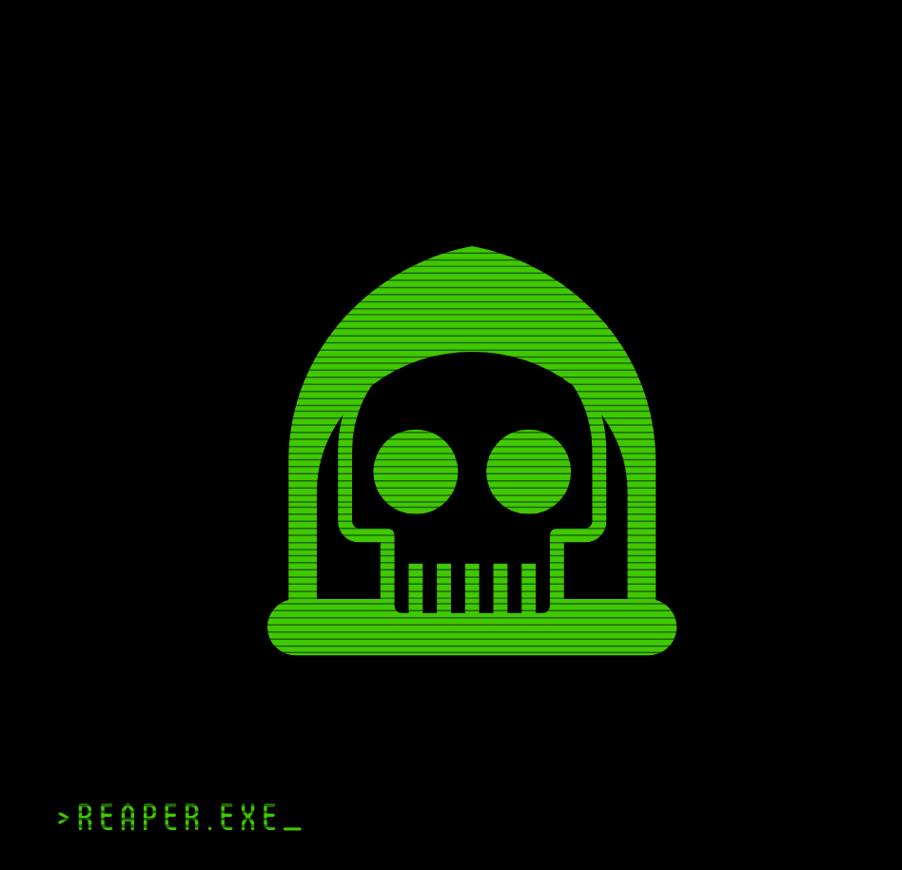
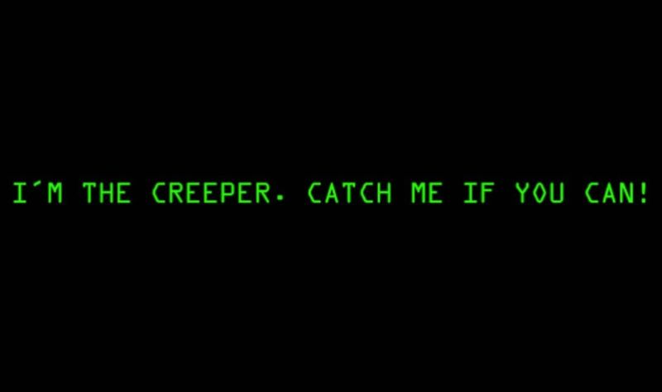
Malware
History
People first started writing malware in the 1970s and early 1980s. They were written as experiments or pranks for fun.
‘Creeper Virus’ created in 1971. It did not cause damage - but did foretell the future of malware with its quick spread through systems. ‘Reaper’ was created to hunt and destroy Creeper - one of the first examples of an ‘anti-virus’ program.
first computer worm
first anti-virus software

Slide 15
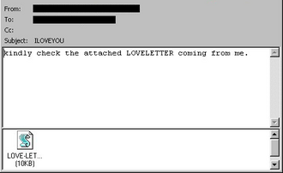
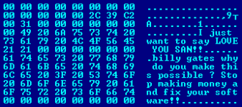
Malware
History
Term ‘malware’ coined in 1990. Use of malware increased in the early 2000s.
LOVE-LETTER-FOR-YOU.TXT.vbs
Blaster Worm (2003)
ILOVEYOU (2000)

Slide 16
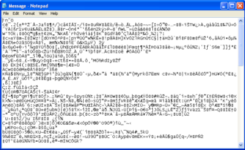
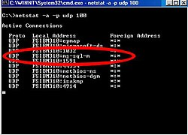
Malware
History
Term ‘malware’ coined in 1990. Use of malware increased in the early 2000s.
exploited a buffer overflow bug
Mydoom (2004)
SQL Slammer (2003)
The worm contains the text message "Andy; I'm just doing my job, nothing personal, sorry,"

Slide 17
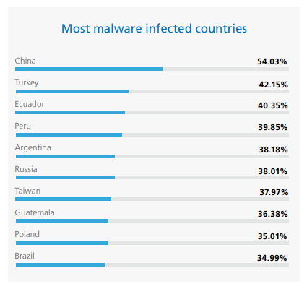
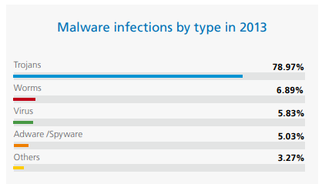
Malware
History
Experts believe that 31.5% of the world's computers have some type of malware installed today.
https://www.pandasecurity.com/en/mediacenter/src/uploads/2010/05/PandaLabs-Annual-Report_2013.pdf

Slide 18
Malware
Basic Types of Propagation
Two main styles of self-replicating malware:
Virus: Infects programs/systems by modifying them
Propagation triggered by user action (e.g., running infected program)
Used as a generic term (“anti-virus” SW detects more than viruses!)
Attaches to legitimate files

Slide 19
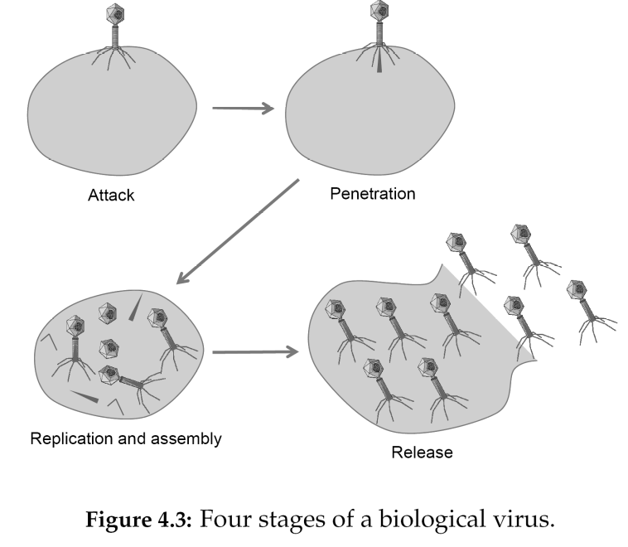
Viruses
Analogy with biological viruses
Similar patterns of infection and spread

Slide 20
Viruses – Basic Concepts
Program Viruses
Term coined by Fred Cohen in 1983
Malicious code attaches to active content
“Active content” can be program, script, boot sector, library, …
VStart:
Virus
Some possibilities:
jmp Start
Good Program
Start: mov eax,…
Good Program
Good Program
Start: jmp VStart
Start: mov eax,…
<next instr>
or
VStart:
Virus
Can break up into many pieces for stealth
mov eax,…
jmp Start+1

Slide 21
Viruses
Boot Sector Viruses (“Bootkit”)
Recall boot process:
Starts firmware (BIOS with POST, initialization, …)
Loads first-stage bootloader (master boot record - MBR)
Runs code found there - typically chains to second-stage BL
Virus gets early and complete control replacing MBR
First PC virus (Brain) was a boot-sector virus
More sophisticated ones can create hypervisor (like BluePill)
UEFI Secure Boot is good protection against this

Slide 22
First PC Virus – “The Brain”
Discovered in 1986
Thought to be the first PC virus “in the wild”
Originated in Pakistan (sometimes called the “Pakistani Brain”)
What it did:
Located itself in high memory and stayed resident
Copied itself to boot sector
Copied original boot sector and extra copies of itself to various disk locations, marked as “bad sectors”
Intercepted all disk read/write requests to fake a read to the boot sector (replaces with original copy)
During disk read/write, spread itself to all uninfected disks
Otherwise no direct damage

Slide 23
Macro Viruses
Data is not always passive!
Many “document formats” (e.g., MS Office) can contain macros
Many files (HTML, e-mail) can contain VBScript or JavaScript
One of the earliest: Melissa (1999)
Used macro access to Outlook address book
Half-fix: MS-Word/Excel/etc now require action to enable macros
How many people click “Enable Macros” without really knowing what this does?!?

Slide 24
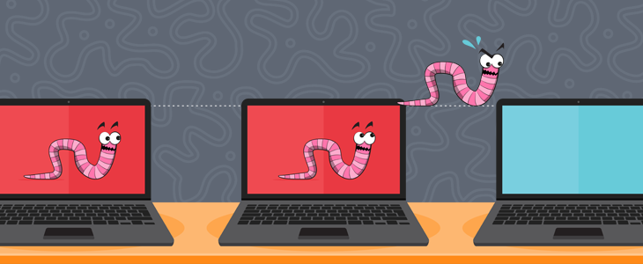
Malware
Basic Types of Propagation
Two main styles of self-replicating malware:
Worm: Spreads copies through a network
Often a stand-alone program (not attached to a program like a virus)
Typically spread automatically (without user interaction)
Exploits vulnerabilities (like buffer overflow) to spread

Slide 25
Worms
Basics - spreading over a network
Changing malware infection vectors
Less “disk swapping” now, but more network connectivity
Not completely different from a virus
Could infect executables after using network to spread
But usually just install on system as extra, complete programs
Spread can either be automatic or require user work
Often try to trick a user into opening an active attachment
File extensions can change to try to trick user (file.pdf.exe)
Recent Cryptolocker spread by GameOver Zeus trojan like this
Automatic spreading by e-mail (e.g., exploiting bug in Outlook) or via vulnerable network services (MS IIS, SQL Server, …)

Slide 26
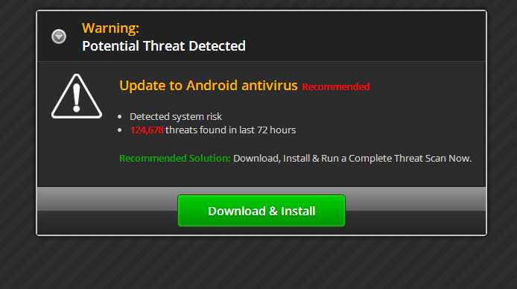
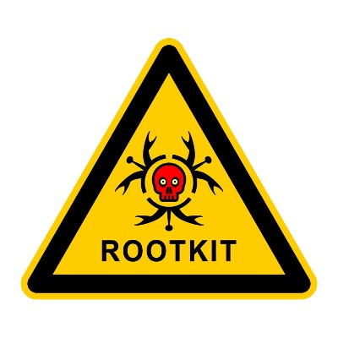
Malware
Basic Types of Concealment or Stealth
How to users are kept unaware of malware:
Trojan Horse: Hides behind some desirable functionality
Malicious code included with game, utility, or other “tempting ware”
“Beware of geeks bearing gifts” - Virgil, 29 B.C. (well, not quite)
Example 1: AIDS Trojan (1989 - physically mailed floppies!)
Example 2: Fake anti-virus software
Example 3: App repackagers (e.g., Shedun on Android - 2015)
Rootkit: Hides very existence of malware
User-level rootkits replace standard system commands
Linux: Replace “ps” (hide processes) and replace “ls” (hide files)
Windows: Replace Process Monitor and Windows Explorer
Kernel-level rootkits go deeper, hiding things from all programs

Slide 27


Malware
Some Possible Actions
Backdoor: Allows unauthorized users access to system
Often an insider attack - e.g., to retain access after leaving
Botnets: Gives an attack a distributed resource
Infected systems are “zombies”
Controlled by a “command and control” technique
Usually a hard-to-trace public channel (IRC, Twitter, …)
Common use: to launch other attacks or send spam - and bitcoin mining!
Privacy-Invasive Software: Sends info about system or user
Spyware – can watch browsing/execution history
Adware - attackers actually sell ads to pop up on victim’s computer
Keystroke loggers – capture passwords, passphrases
Have even tapped into webcams!
Ransomware: Encrypts files so users don’t have access
Typically demand payment in bitcoin for decryption key

Slide 28

Malware
Some Possible Actions

Slide 29
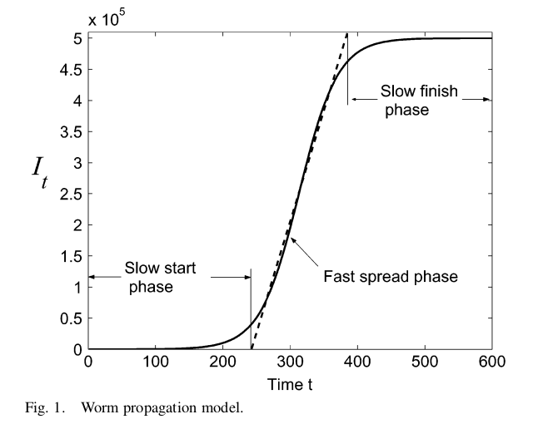
Spread of Malware
Modeling and understanding propagation
Carrying “virus” analogy forward…
Models of biological epidemics work:
Key variables:
N = number of vulnerable hosts
I_{t} = infected hosts at time t
S_{t} = susceptible hosts at time t
β = infection rate
Basic relations:
I_{t+1} = I_{t} + β I_{t} S_{t}
S_{t+1} = N - I_{t+1}
Cliff C. Zou, Weibo Gong, Don Towsley, and Lixin Gao. 2005. The monitoring and early detection of internet worms. IEEE/ACM Trans. Netw. 13, 5 (October 2005), 961-974.

Slide 30
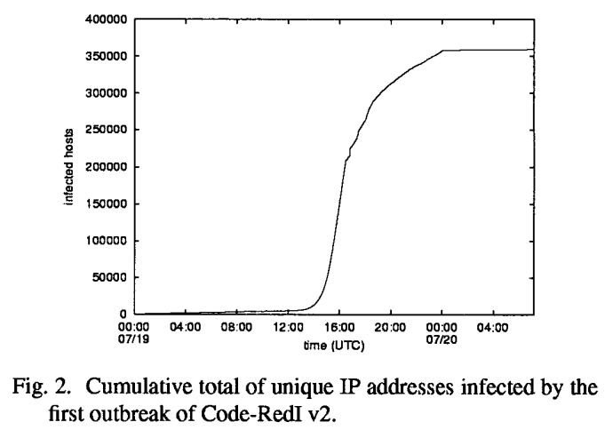
Spread of Malware
Modeling and understanding propagation
A theoretical model is nice, but….
Does it reflect reality?
Yes!!
David Moore, Colleen Shannon, and k claffy. 2002. Code-Red: a case study on the spread and victims of an internet worm. In Proceedings of the 2nd ACM SIGCOMM Workshop on Internet measurement (IMW '02), pp. 273-284.

Slide 31
Detecting Malware
Two broad classes of detection techniques
Signature-Based: Recognizes “known-bad” code
Vendors have teams analyzing malware and updating signatures
Often can avoid detection with minor modifications
Users must keep known virus database up to date!
Caution: Many anti-virus programs w/new computers have a limited “free trial period” for virus updates – then stop!
Can do full file-system scans or dynamic monitoring - both is best!
Good: Reliable with low false-positives
Bad: Must know malware, so 0-days slip by
Anomaly Detection: Detects unusual activity
Reading/writing a large number of files
Detect code tied in to event handlers (keyboard loggers)
Good: Can detect even unknown malware / 0-days
Bad: Tends to be a lot of false positives
Misbehaving/bad software can be quarantined.

Slide 32
Attackers vs Protectors
The arms race….
New detection techniques invented regularly….
New evasion techniques invented regularly…
Who will win?
Some evasion techniques in response to better Antivirus:
Polymorphic or encrypted viruses
Core code is presented differently in different versions
Example: Virus code is encrypted with different keys
Often a key piece (decryptor or virus morpher) can be recognized
Metamorphic viruses
Entire code changes through functionality-preserving transformations
Can shuffle registers used, add useless code, use equivalent ops, ...
Much harder to detect!

